Slide 1

Dementia Friendly Business Training Session

Slide 2
Learning Outcomes
Understand what dementia is – myths and facts
Understand what a Dementia Friendly Community is and its goals
Tips on dementia risk reduction
Tips for helping customers with dementia
Tips for creating dementia friendly environment at work
Get familiar with resources in your community

Slide 3
What is dementia?
Dementia is not a disease but a group of symptoms.
Symptoms include:
  Memory loss
  Challenges with thinking and decision-making
  Communication difficulties
  Changes in mood and behaviour significant enough to affect daily life.
Notes:
What is dementia . Ask audience.

Slide 4
What is a Dementia Friendly Community?
The UK Alzheimer Society defines a Dementia Friendly Community as:
“One in which people with dementia are empowered
to have high aspirations and feel confident,
knowing they can contribute and participate in
activities that are meaningful to them”
Notes:
Support those with dementia and their caregivers - feel included and supported in the places where they work, live and socialize
Provide community based support and services for those living with or affected by those living with dementia
All have a role to play in creating a “Dementia Friendly Community” – caregivers, businesses, service providers

Slide 5
What are the goals of a Dementia Friendly Community?
Build community capacity to support individuals to age in place and remain in community for as long as possible
Raise awareness of dementia to reduce stigma

Slide 6

Myths about Dementia
Dementia is NOT…
Strictly a genetic disorder
A disease that only affects older people
Normal part of aging
Notes:
While there are some forms of dementia that are genetic, these are fairly rare – only about 3% of all cases. Most are called “sporadic” which means there are a variety of factors that result in a dementia. These include things like age, lifestyle, and other health concerns or issues that can act to raise someone’s risk of developing dementia.
-Age is the largest risk factor for developing dementia; but dementia can occur in the young as well. Young-onset dementia refers to dementias that develop in people under the age of 65. In some cases, people in their 40’s can develop dementia, and people with young-onset dementia face a variety of different challenges in getting appropriate care and addressing their situation as their needs are very different from people over the age of 65.
-dementia is also not a normal part of aging; the symptoms of dementia go beyond the normal, expected losses of ability and function we should expect with age.
For further information on Genetics of Dementia, help sheet is available: https://www.fightdementia.org.au/files/helpsheets/Helpsheet-DementiaQandA12-GeneticsOfDementia_english.pdf

Slide 7
Myths about Dementia
Dementia does NOT mean…
The end of a meaningful life
That a person cannot understand what
is going on around them
That a person will become violent or
aggressive
Notes:
No two people are the same, the trajectory of the disease is different for everyone as well as some of the losses that occur as a result of the disease. Ie, not everyone loses speech.
There is still the opportunity for someone with dementia to live a purposeful and meaningful life
People with dementia still have awareness of what is going on around them; perhaps not the specifics but the emotional content of what is happening is apparent to them

Slide 8
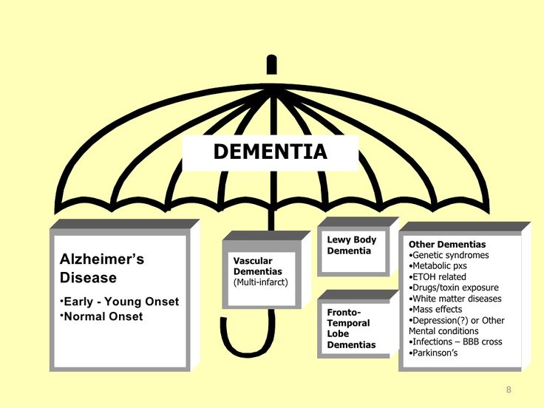
Types of Dementia
Notes:
This slide shows a quick visual of the difference of the word Dementia and Alzheimer's and why you will hear us use the word Dementia throughout this presentation.
Dementia is a term like a “car” ;there are lots of cars on the road, but what kind of car is it? A Ford? A Toyota?
So you will hear us use the word Dementia as the overall disease of the brain or specifically :
It’s a disorder of the mental processes caused by brain disease and marked by memory disorders, personality changes, and impaired reasoning.
The next question is what kind of dementia do you have? Alzheimer's is the one you are most familiar with. Lewy Body, Vascular, fronto- Temporal Lobe, etc.
.

Slide 9
How might you know if someone has Dementia?
Problems with memory
Difficulty with familiar tasks
Disorientation of time or place
Unable to find the right words
Problems with abstract thinking
Challenges following conversations
Poor judgement
Notes:
You cannot tell if a person has dementia by looking at them. However, if they look like they are lost or trying to find something or maybe distressed, offer to help. Simply by saying, “May I help you?” you can help put them at ease. The worst thing to do is ignore them or walk away. They will remember how they felt during the interaction or lack there of.
People with dementia have what is called “Heightened Intuition” – their loss of reasoning ability to navigate the environment leads to heightened sensitivity to others’ emotions and non-verbal communication.
**Show companion cards here. A person with dementia may have a caregiver along with them. They may hand you or a clerk a card that says “My companion has a memory impairment. Thank you for your patience.” Not all people will have or use the card, but it is helpful in certain situations and helps orient all parties to the situation and helps the person with dementia feel safe.
Disorientation of time and place – for example becoming lost in their own street
Poor judgement – for example wearing heavy clothing on a hot day or not realizing that an item needs to be paid for

Slide 10





Dementia Risk Reduction Tips
Notes:
Physically active – for at least 30 minutes per day, 5 times per week, ensure heart rate raised
Healthy diet – healthy mediterranean diet has a high proportion of oily fish, fruit, vegetables, unrefined cereals and olive oil, and low levels of red meat and sugar.
This diet reduces risk of dementia and heart disease, stroke and type 2 diabetes. Try to cut down on trans fat (eg cakes, cookies, most cheeses) and limit sugary treats.
Keep an eye on your salt intake too, because salt raises your blood pressure and risk of stroke. Read food labels to see what’s in them and seek out healthier options.
- Alcohol limit – 1 standard drink – women (5oz), 2 standard drinks for men (10oz)
- Max per week – 3- 5 for women
- Max per week – 5 – 7 for men
Get regular health checks done
Brain daily workout - reading, doing puzzles, word searches or crosswords, playing cards or learning something new - maybe another language. If you can keep your mind active you are likely to reduce your risk of dementia.
Reduce stress - - through yoga, tai-chi, meditation, music, art etc.
Good social network may also reduce your dementia risk. Visit people or have them visit you, join a club or volunteers
Maintain healthy body weight etc
Prevent falls - avoid icy paths, home safety measures – no loose rugs, hand rails etc, improve stability – balancing exercises, protect your head
Source: Alzheimer’s Society UK , Alzheimer Society of Calgary: https://www.youtube.com/watch?v=d-t3kf3HF-0&feature=youtu.be

Slide 11
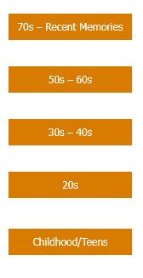



What does it feel like?
Notes:
Let me share an analogy on how it feels to have the disease.
Imagine a 70 year old woman who has dementia. Imagine there is a full bookcase beside her, as tall as her, and each book represents one of her skills or memories. On the top shelf are the most recent memories. Memories of her 60s are by her shoulders, those of her 20s by her knees and her childhood at her feet.
Dementia rocks her bookcase and her books start to fall off, starting with the top shelf first. When her top shelves are empty she might find herself living in the past, lower down her bookcase. If she finds herself living in the 1950’s, she may not know the name of the Prime Minister or the day of the week. She might be confused about why her home looks different, or why she has an electric kettle rather than a whistle kettle or why the TV has no knobs. Once you understand that this is her reality, you can better support her.
The bookcase analogy helps to explain that there are different types of memory. Factual memories are books that will fall quickly. Emotional memories, on the other hand, remain in the memory longer.
With the example of our 70 year old woman, her daughter may visit to find that her mother can no longer remember her name. She will, however, remember her feelings from that visit, feelings of love, comfort and support. Equally, if the mother and daughter were to argue, the mother might not remember the details of the argument, but she will remember the feelings of anger and hurt from the exchange.
This analogy shows how dementia can feel. Memory loss and confusion that can accompany dementia make it difficult for individuals to carry out daily activities such as shopping, banking and moving throughout the community. Misunderstanding prices and sales, forgetting to pay prior to leaving the store, difficulty with debit or credit cards and being unable to find the desired item or even come up with the name of the item are common problems that can result from dementia.
A community that is aware and understands the disease helps them feel safe and less frustrated.

Slide 12
Small changes help make a
Dementia Friendly Community
https://www.youtube.com/watch?v=Fz8ACEu7Lho
In this film we see Mary as she encounters people in her community, and see how a little bit of time and consideration for people living with dementia can make all the difference to their daily lives.
Notes:
This 3 minute video was made in United Kingdom.
Notice where she puts the tea and coffee - in the wrong places, after breakfast.
She goes out on public transportation, has difficulty at the bank, and tries to shop at the grocery store.
The noise really affects her.

Slide 13

Know How to Communicate
Smile warmly, approach from the front and attempt to make eye contact
Approach low, slow, from the front for individuals in a wheelchair
Minimize distractions
Make one point at a time
Allow time for response
Ask close-ended questions
Do not correct
Respond to a look of distress
Keep it simple
Treat person as an adult
Notes:
Don’t make assumptions about a person’s ability to communicate because they are living with dementia. The disease affects each person differently
Minimize distractions
Get the person’s attention before touching
Approach from the front and make eye contact
Initiate by extending hand as if for a handshake
Shake hand, slide palm to palm, moving beside person
Speak naturally and respectfully
Smile
Always treat with dignity and respect
Be attentive and understanding
Never tell a suspected person with dementia that they are wrong or that they have misunderstood – “I’m sorry, I didn’t mean to upset you , how can I be of support/help?”
Validate emotions – “I can see that you are upset. That would bother me too.”
Never argue or correct
Keep it simple
Ask one question at a time, make sure they understood what you are asking and allow time to respond
Use words and phrases that are as concrete as possible
Avoid lengthy explanations or trying to reason
Rephrase rather than repeat
Be Patient
Sensing your frustration and impatience, the person may become further agitated, may try to leave, or become more aggressive
Be reassuring
Someone with dementia may not remember the words that were spoken to them, but they remember how they felt and the experience they had at your business. They remember if they want to return or not.

Slide 14
Be Aware of your Body Language
Maintain positive attitude
  Positive tone of voice
  Be patient
Be aware of non-verbal communication
  Gestures
  Facial expressions
  Posture
Meet the person on their level
Notes:
Use personal examples based upon the business.
Feelings are very important – show you care
Politely state: I can tell you are upset, can I help? Or I’m so sorry you are upset, let me find you a chair.
Maintain positive attitude
Positive tone of voice
Be patient
Be aware of non-verbal communication
Gestures - Give visual cues. To help demonstrate the task, point or touch the item you want the individual to use. Or, begin the task for the person.
Facial expressions - Sometimes the emotions being expressed are more important than what is being said. Look for the feelings behind words or sounds.
Posture – using open postures (arms open, not crossed), can come off more welcoming and kind when communicating
Body language: no eye rolling or sighs, allow them extra time.
Meet the person on their level
-e.g., Physically bending down if they are in a chair instead of standing over them.
Accept: People with dementia are always doing their best. We can’t change them, but we can change our response.

Slide 15
When to Seek Help
Wandering
Physical distress
Severe emotional distress
What to do:
  Ask to call a family member
  Call 911

Slide 16
Communicating in a Retail Setting
Responses to occurrences in a retail setting:
Forgetting to pay
Remembering and finding items
Making choices
Handling money
Practice/Discussion: Discuss key points on how you and your team would handle a possible situation with someone who may be experiencing dementia.
Notes:
Grocery shopping - challenging for individuals with dementia
Memory for what is needed
Item name
Item location
Self service overwhelming
Difficult to follow set of instructions
Using debit/credit card frustrating as number of questions on payment keypad
Give out Case studies handout

Slide 17
Retail Setting Strategies
Potential “relaxed” lane for service
Additional time and assistance given to customers
Clear signage – basic black letters on light background in large font at end of each aisle
Provide staff to assist and accompany customers to complete tasks

Slide 18
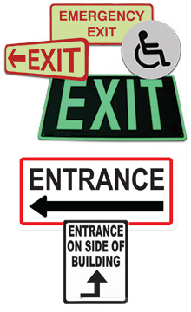
How do you create a Dementia Friendly physical space?
Small changes can make a big difference
in having the space feel safe to someone
with dementia:
Entrances should be clearly visible
and understood as an entrance
Directional signage should be clear
Access to wheelchair ramps

Slide 19
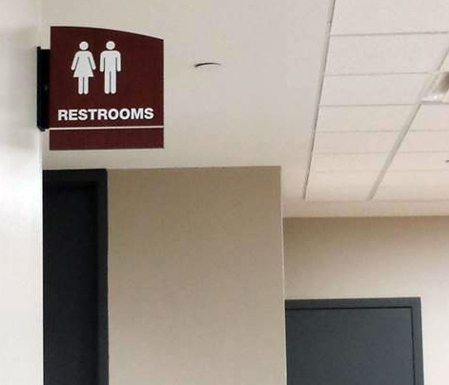
How do you create a Dementia Friendly physical space?
Use high-powered lighting
using natural light whenever possible.
Use plain flooring – not shiny,
not slippery.
Have family/unisex restrooms
or changing facilities.

Slide 20
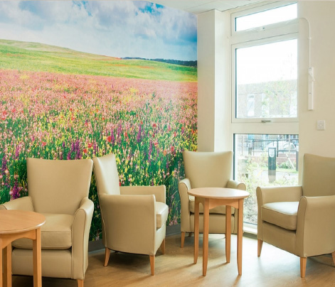
How do you create a Dementia Friendly physical space?
Design quiet areas for someone
who may be feeling anxious or confused.
Include seating in large spaces
(i.e. waiting areas) to help someone relax.
Ensure areas are free of clutter and
arranged for easy physical movement.

Slide 21

How do you create a Dementia Friendly physical space?
How can your organization create
a more dementia friendly physical
environment?
What ideas should you consider?
Practice/Discussion: What is one idea you learned that you will implement within the next month to become more Dementia Friendly @ Work?

Slide 22
Resources Available
Healthlink Dementia Advice – 811
Alzheimer Society of Calgary - www.alzheimercalgary.ca
Strategies to Improve Brain Health (Alzheimer Society of Calgary) https://www.youtube.com/watch?v=d-t3kf3HF-0&feature=youtu.be
Notes:
Mention to the audience if anyone is personally affected by a family member/friend with dementia, please feel free to follow up. Ensure business card/ contact details are left.

Slide 23
References
Dementia Friends Workshop presentation - Alzheimer Society of British Columbia
Intro to Dementia 1.4 presentation- Alzheimer Society of Calgary
Dementia Friendly @ Work Training Session - Act on Alzheimer’s
Dementia Friendly Business Training - Dementia Coalition of Chippewa County
Definition of Dementia Friendly Community - Alzheimer Society UK
“Small Changes” video – Alzheimer’s Society UK
Dementia Risk Reduction Tips – Alzheimer’s Society UK

Slide 24
Thank you
Thank you for attending this training session and for working to become more Dementia Friendly
Contact Info:
Name
email
Phone number

